Slide 1
Following the Tech Industry
Analysis of job and housing data to determine where to apply
Dziugas Butkus | Josh Tyndale | Stephen Harayda
CS 455: Distributed Systems

Slide 2

Introduction
-New Grads
-Following the money
-Miami/Texas

Slide 3
Problem Characterization
-Access to meaningful data
-Multi-layered problem. Job availability is not the only criteria.
-Data needs to correlate in time for meaningful assumptions to be made.

Slide 4
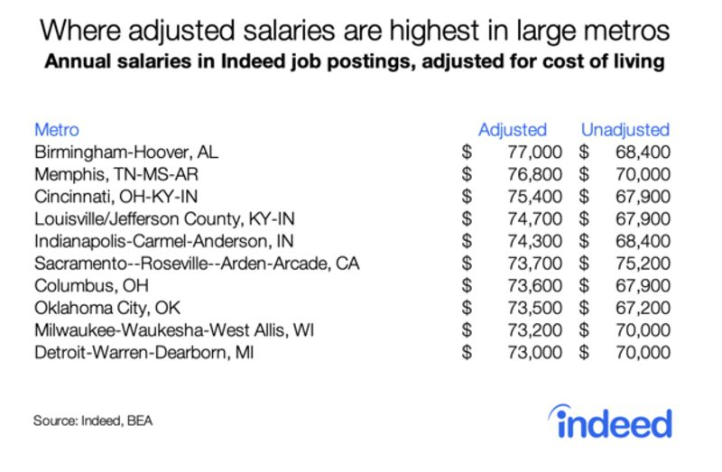
Past Approaches
Salaries adjusted for cost of living
Total job availability
Survey of employees to identify salary and satisfaction

Slide 5
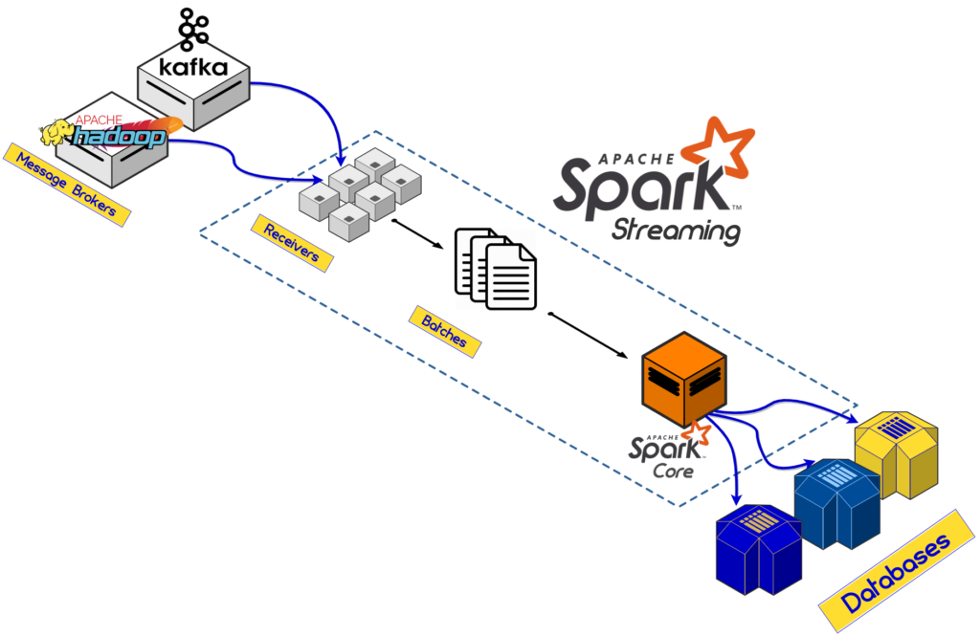
Methodology (Setup)
PySpark (python implementation of Apache Spark)
DataFrames (similar to RDD’s)
Evaluated both Job and Housing
datasets

Slide 6
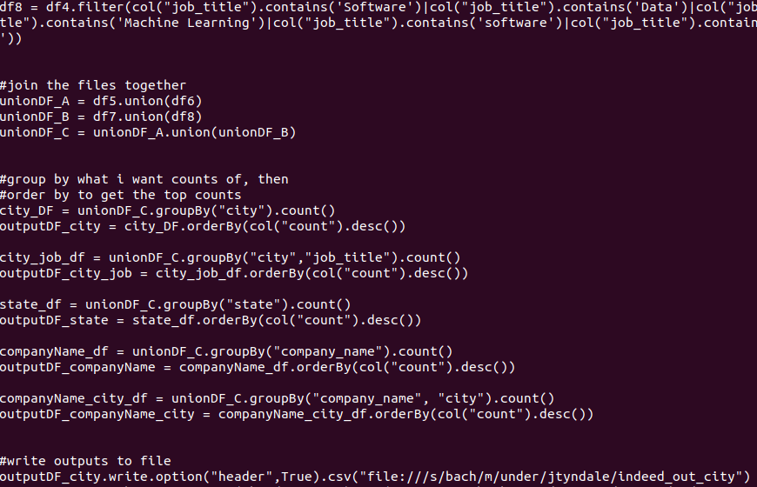
Methodology (Execution)
Indeed and Craigslist - read csv
Filter
Combine
groupBy()
count()
orderBy() etc

Slide 7
Methodology (results)
All outputs were recorded and put in a single location
Outputs were cross referenced with each other

Slide 8
Benchmarks
Linux OS
Spark used with 10 workers and 1 master
Indeed job data set and craigslist rental dataset
What we did:
Occurrences of postings
Listed in order of descending
Grouped by city/state/company etc

Slide 9
Insights Gleaned
Results of data analysis can be skewed based on error/bias
Good/reliable data is hard to come by

Slide 10
Transformation of Problem Space
-Data is a valuable asset and becoming more private
-Development of machine learning for sentiment analysis

Slide 11
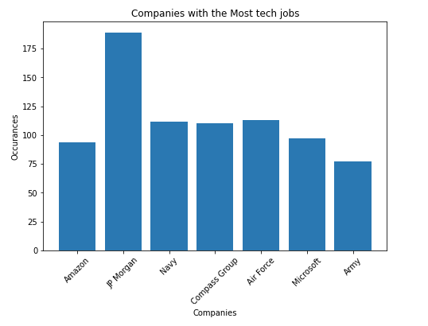
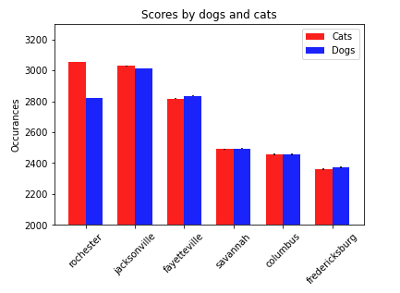
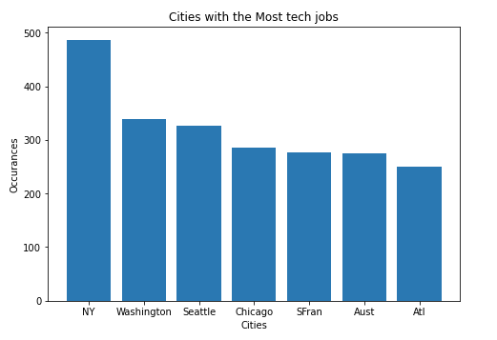
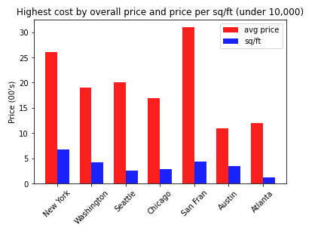

Slide 12
Conclusion
Our official lists:
Washington DC, Seattle, Chicago, Austin, Atlanta
Amazon, JP Morgan, Navy, Compass Group, Air Force, Microsoft, Army

Slide 13
References
https://logz.io/blog/hadoop-vs-spark/
https://www.bloomberg.com/news/articles/2019-09-05/ranking-cities-by-salaries-and-cost-of-living

